Slide 1


ANALYZING HEALTH EXPENDITURE
Team 5:
ABHISHEK GUPTA
KATHERINE BARRIO
TANYA MALIK
TIANHAO ZHAO
WASEEM MEHAR

Slide 2
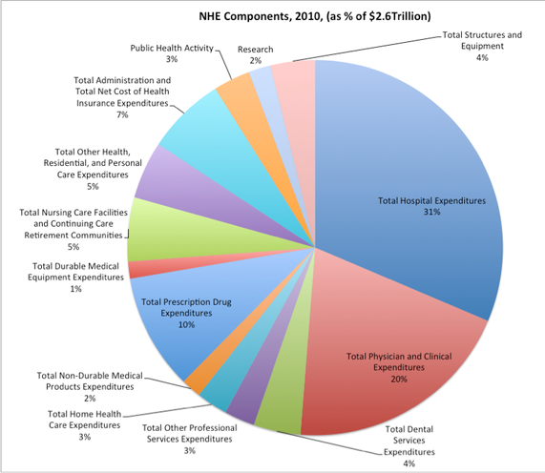
Introduction
Healthcare Spending
$3.5 trillion or $10,739 per person
Percent of GDP
17.9%
Notes:
-Wisconsin School of Business Open Datasets for Actuarial and Financial Applications
-Provides a number of projects that focus on topics that are of interest to actuaries.
One of the topics was trying to predict future healthcare expenditure
using the Sample from Medical Expenditure Panel Survey ( MEPS)
-Is a survey that provides estimates of health care use, expenditures, source of payment and insurance coverage
-CONDUCTED BY us Agency of Health Research and Quality

Slide 3
Business Problem
Original Problem
Can we predict Out of Pocket Costs?
Can we predict number of visits patient will have in a year?
New Problem
Can we predict a patient’s Risk Class

Slide 4
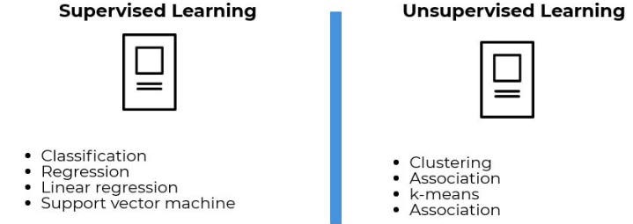
Literature
-Supervised Learning Methods for Predicting
Healthcare Costs

Slide 5
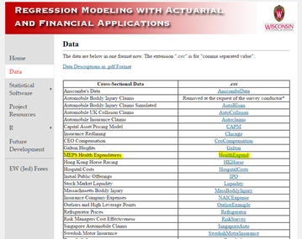
Data Source
Wisconsin School of Business Open Datasets for Actuarial and Financial Applications
Sample from Medical Expenditure Panel Survey ( MEPS)
Notes:
-Wisconsin School of Business Open Datasets for Actuarial and Financial Applications
-Provides a number of projects that focus on topics that are of interest to actuaries.
One of the topics was trying to predict future healthcare expenditure
using the Sample from Medical Expenditure Panel Survey ( MEPS)
-Is a survey that provides estimates of health care use, expenditures, source of payment and insurance coverage
-CONDUCTED BY Department of Health and Human Services

Slide 6
Data Description
Size is 18,735 individuals before cleaning
including data for Ages 18-65
File types of the data are in SSP (SAS Transport File) file type
Read data format in R then converted to CSV
R script:
>install.packages("foreign")
>library(foreign)
>data= read.xport("C:/Users/m317199/Desktop/Personal/School/Python/project/data.ssp")
>write.csv(data,"C:/Users/m317199/Desktop/Personal/School/Python/project/Data.csv", row.names = FALSE)

Slide 7
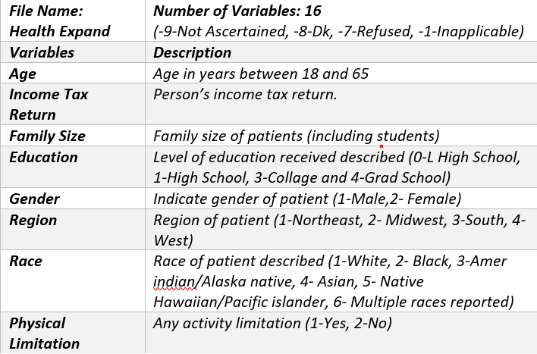
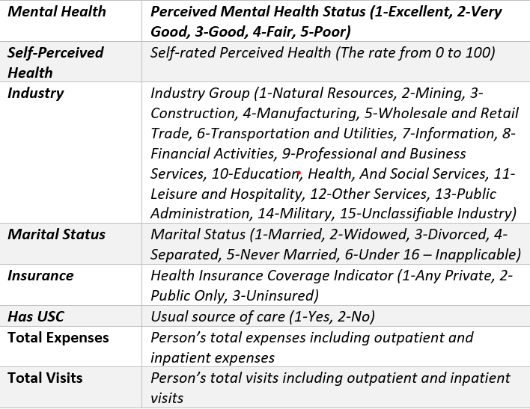
Data Description
Notes:
Tian

Slide 8
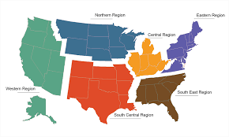


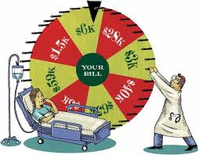






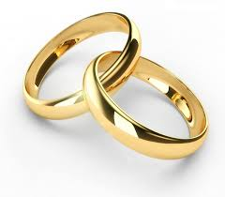
Data Description
Region
Income
Age
$
Gender
Medical Expenditures
Race
Family Size
Phys Limitation
=
Industry
Insurance
Education
Marital Status

Slide 9
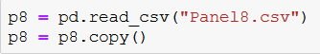
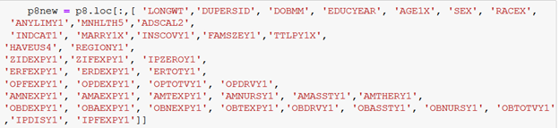
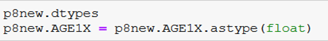
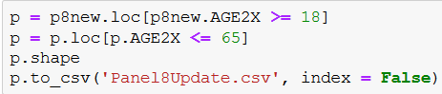
Data Processing: Creating a new dataset
First Dataset: observations: 2000, 28 features, Original data had over 3000 features
Panel 7 Year 2 and Panel 8 Year 1
What to keep
What we added
For Each Panel:
Read and copy
Locate the columns we need:
Only include the ages from
18 to 65

Slide 10
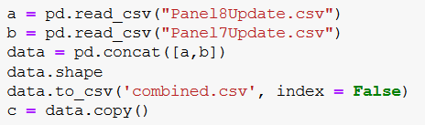
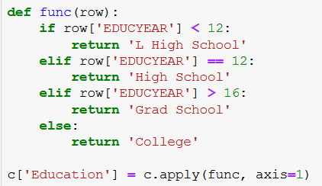
Data Processing: Creating a new dataset
Next Step: Combine data and create columns we needed
Concatenate Data
Create new rows
Educate Years to Category Name (High School, etc.)
Educate Years to Category (0-4)
Race to Category (1-5)
Gender to Male/Female
Marry 2X to Category Name (Married, etc.)
Mental Health to Category Name (Excellent, etc.)
Industry to Category Name (Manufacturing, etc.)
Region to Category Name (West, etc.)
Insurance Coverage to Category (Public, etc.)

Slide 11
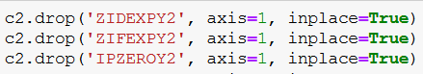
Data Processing: Creating a new dataset
Next Step: create columns we needed, rename and reorder data
Create Summing rows
Total ER OP Expenses
Total ER OP Visits
Total OB OP Expenses
Total OB OP Visits
Total OP Expenses
Total OP Visits
Total Expenses
Total Visits
Rename Columns
Reorder Columns
Drop Summing Columns
Save as new Dataset :: 18435 rows

Slide 12
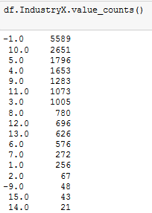
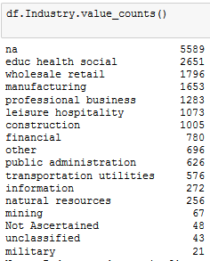
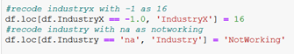
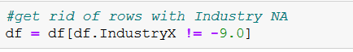
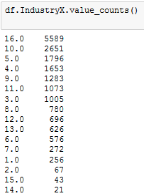
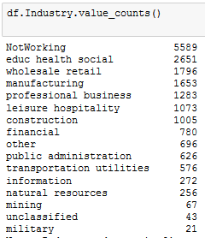
Data Cleaning
Checking for negative numbers
Recoding Certain Values
Explore with value_counts
Find and change certain values
IndustryX : change -1 to 16 (NA to Not Working) :: 5589 rows
Assumption - no industry indicates no job
RegionX: change -1 to 5 (NA to None) :: 175
Assumption - NA has meaning, homeless etc.
Physical limitation: -9 to 2 (Unknown to No)
Assumption - If a physical limit is present, it would be noted in chart. Don’t note if not present.
Dropping Rows
Explore with value_counts
Drop rows with certain values
Industry -9 :: 48 Rows
Family Size -1 :: 179 rows
Mental Health -1,-9,-8,-7 :: 157
Years of Education :: 127

Slide 13
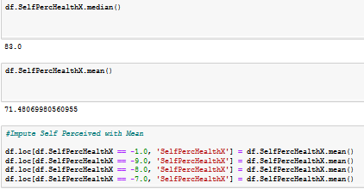
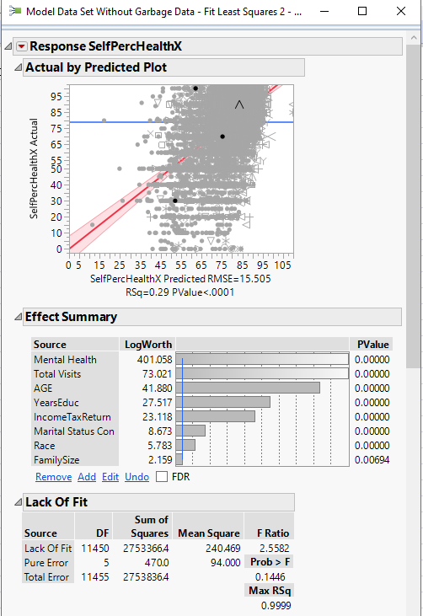
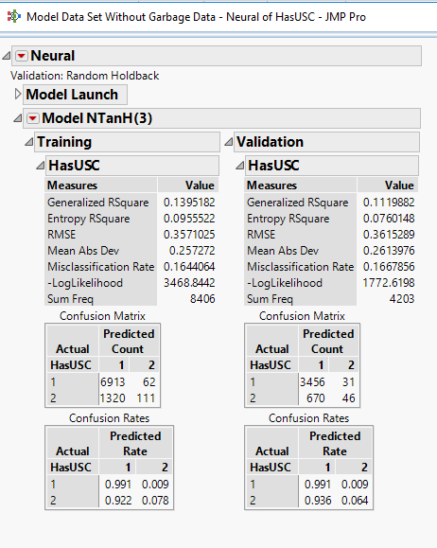
Data Cleaning : Imputation
Checking for negative numbers
Imputation
Self Perceived Health :: 1164
Mean
Linear Regression ( Jmp)
Has USC :: 45
Mean
Neural Network (JMP)

Slide 14
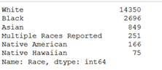
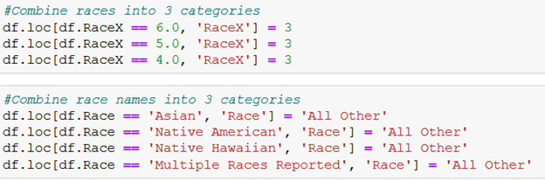
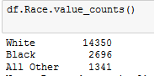
Data Transformation: Grouping Features
Use Function to group uneven distributions
Race to Black, White, Other
Industry to Sitting, Standing, Labor, Unemployed
Expenses to None, Low, Med, High

Slide 15
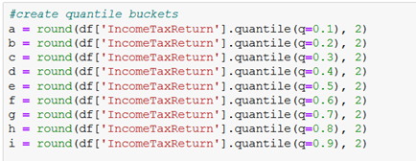
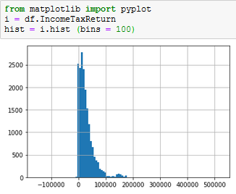
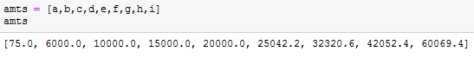
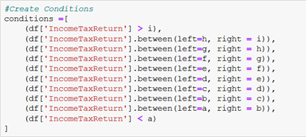
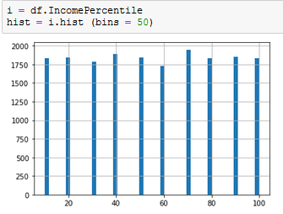
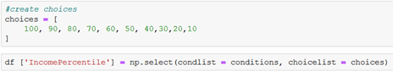
Data Transformation: Grouping by Percentile
Check Histogram for Distribution
Create Quantile Buckets
Check Values
Create Conditions
Create Choices
Create New Row With Percentile
Age, Income, Expenses

Slide 16
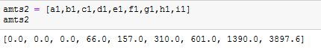
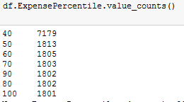
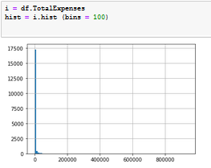
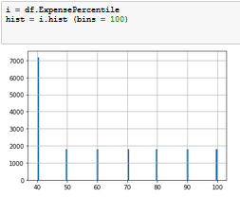
Data Transformation: Grouping by Percentile
The problem with expenses
40% have $0 expenses

Slide 17
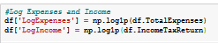
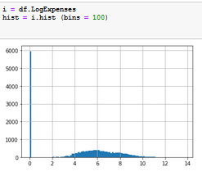
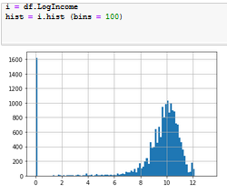
Data Transformation: Log Values
Income, Total Expenses

Slide 18
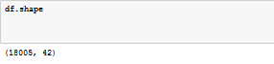
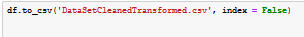
Final Dataset
Check Size
Save

Slide 19
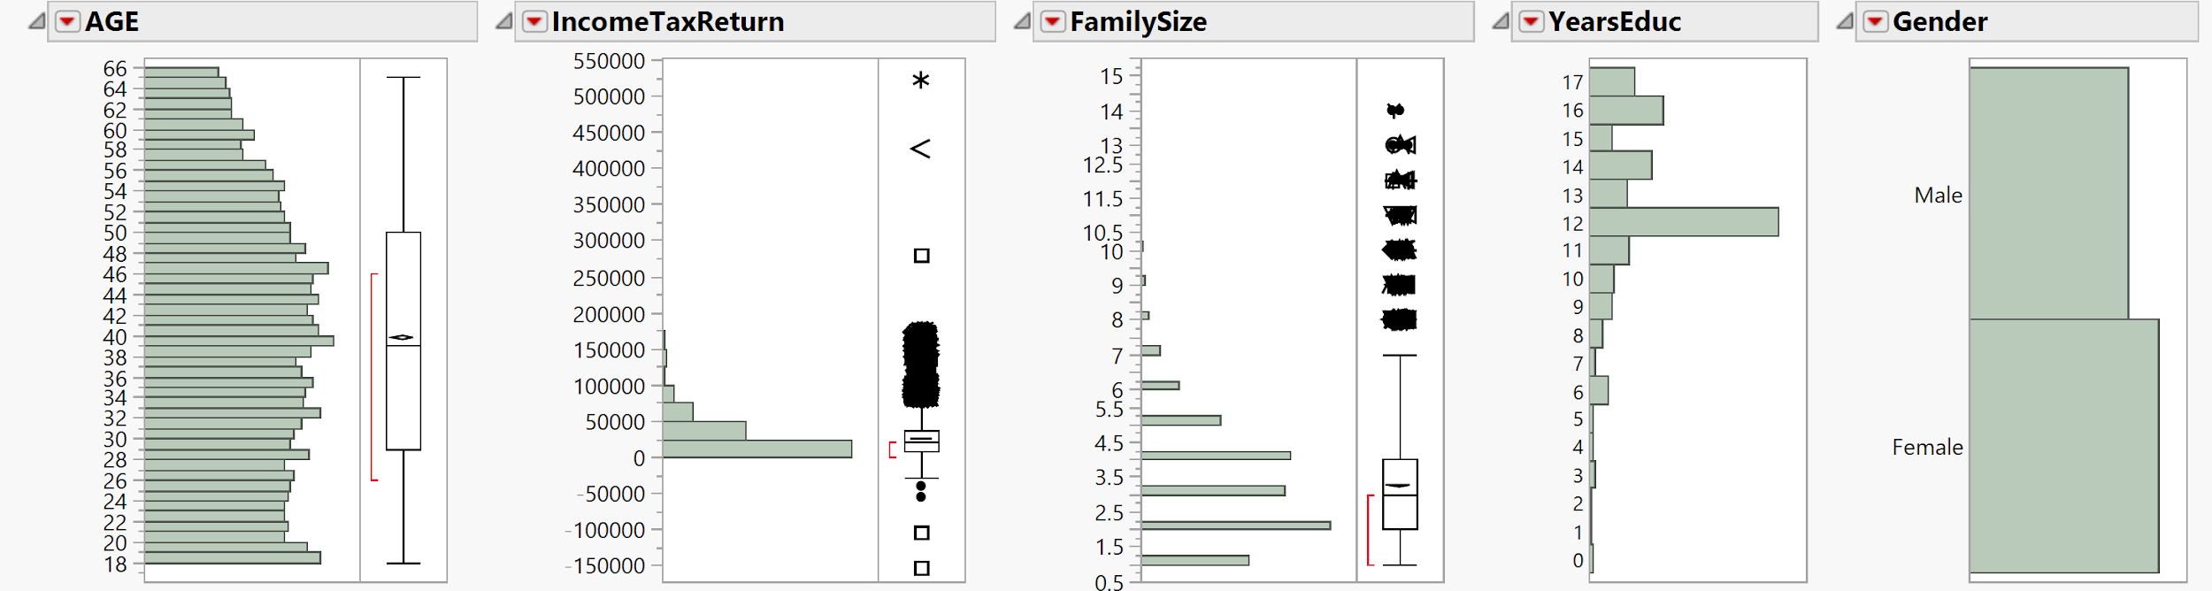
Data Distributions

Slide 20
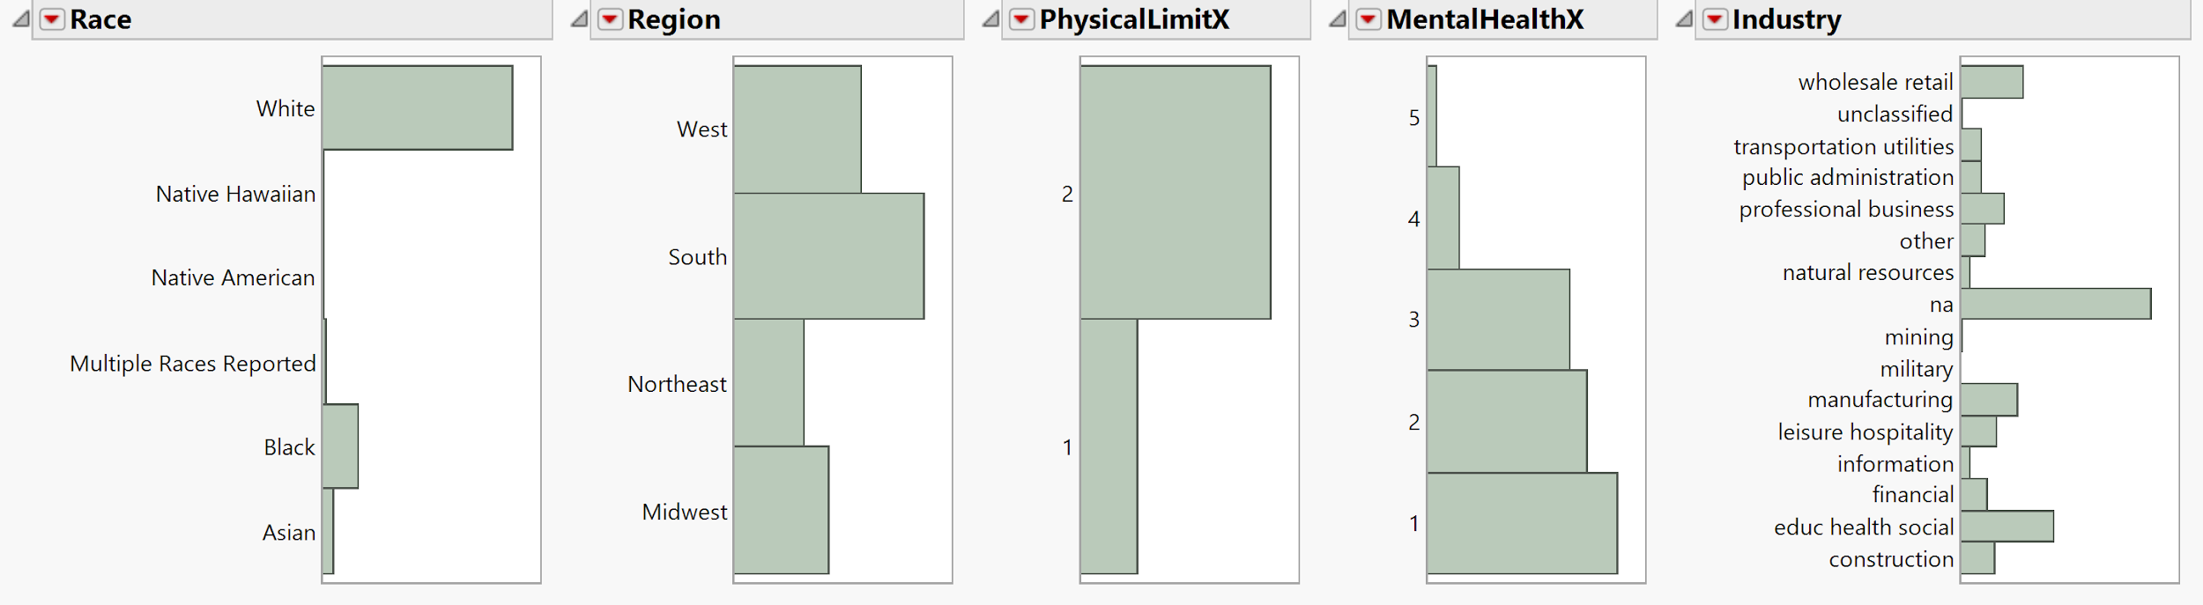
Data Distributions

Slide 21
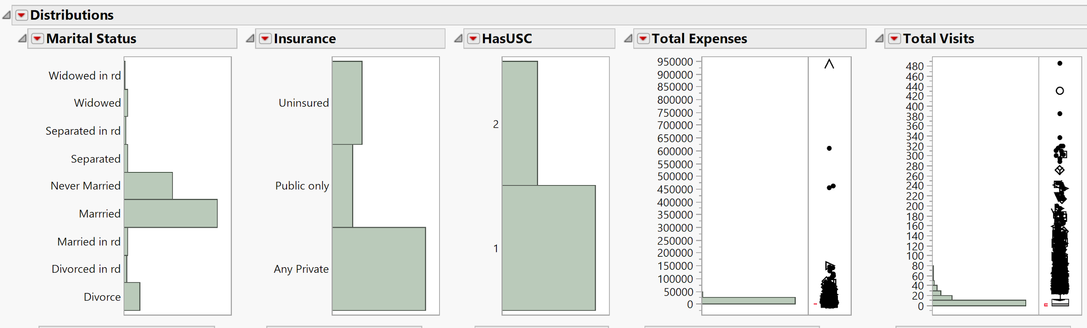
Data Distributions

Slide 22
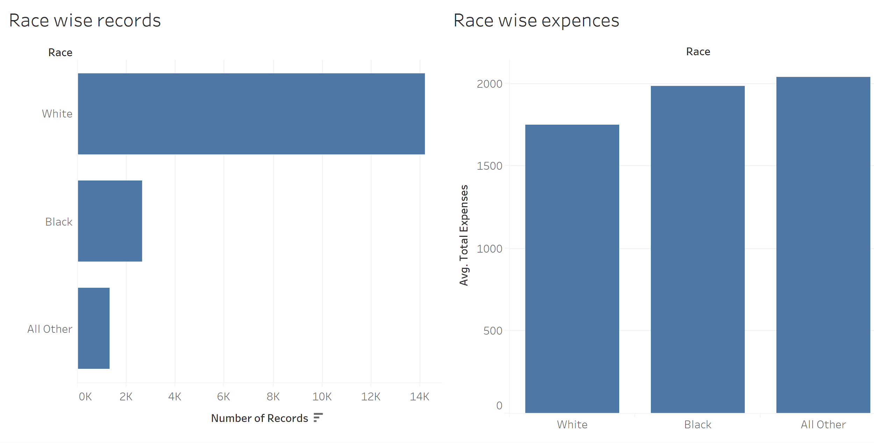
Data Exploration
White folks have the least total expenses

Slide 23
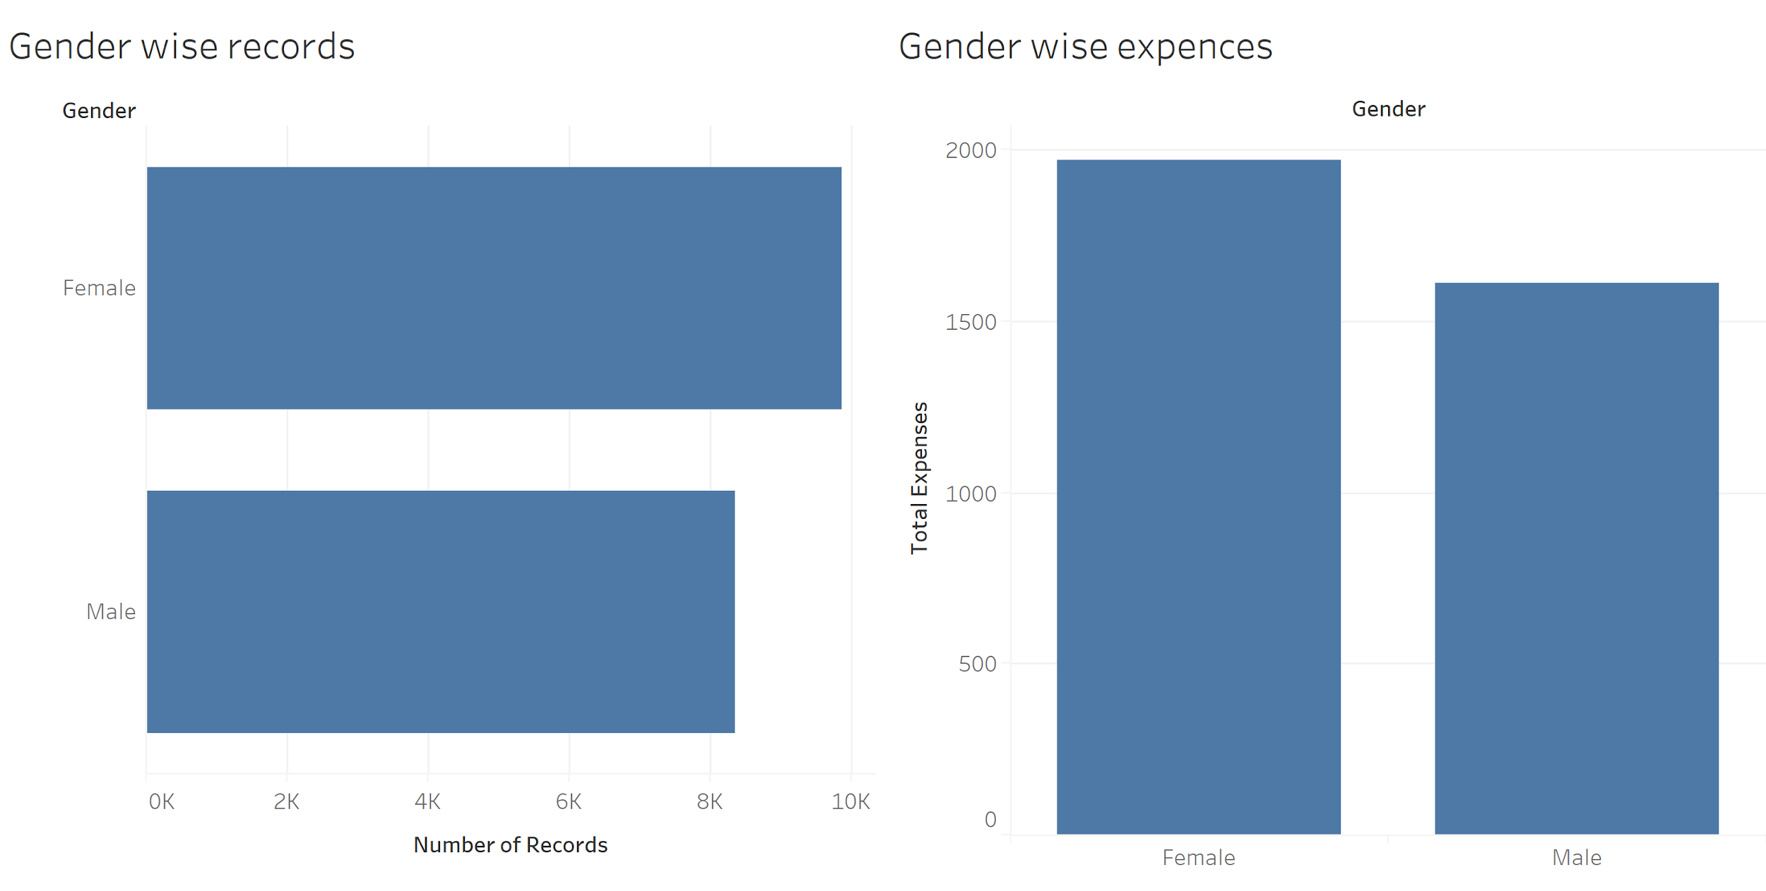
Data Exploration
Females have significantly higher total expenses than males

Slide 24
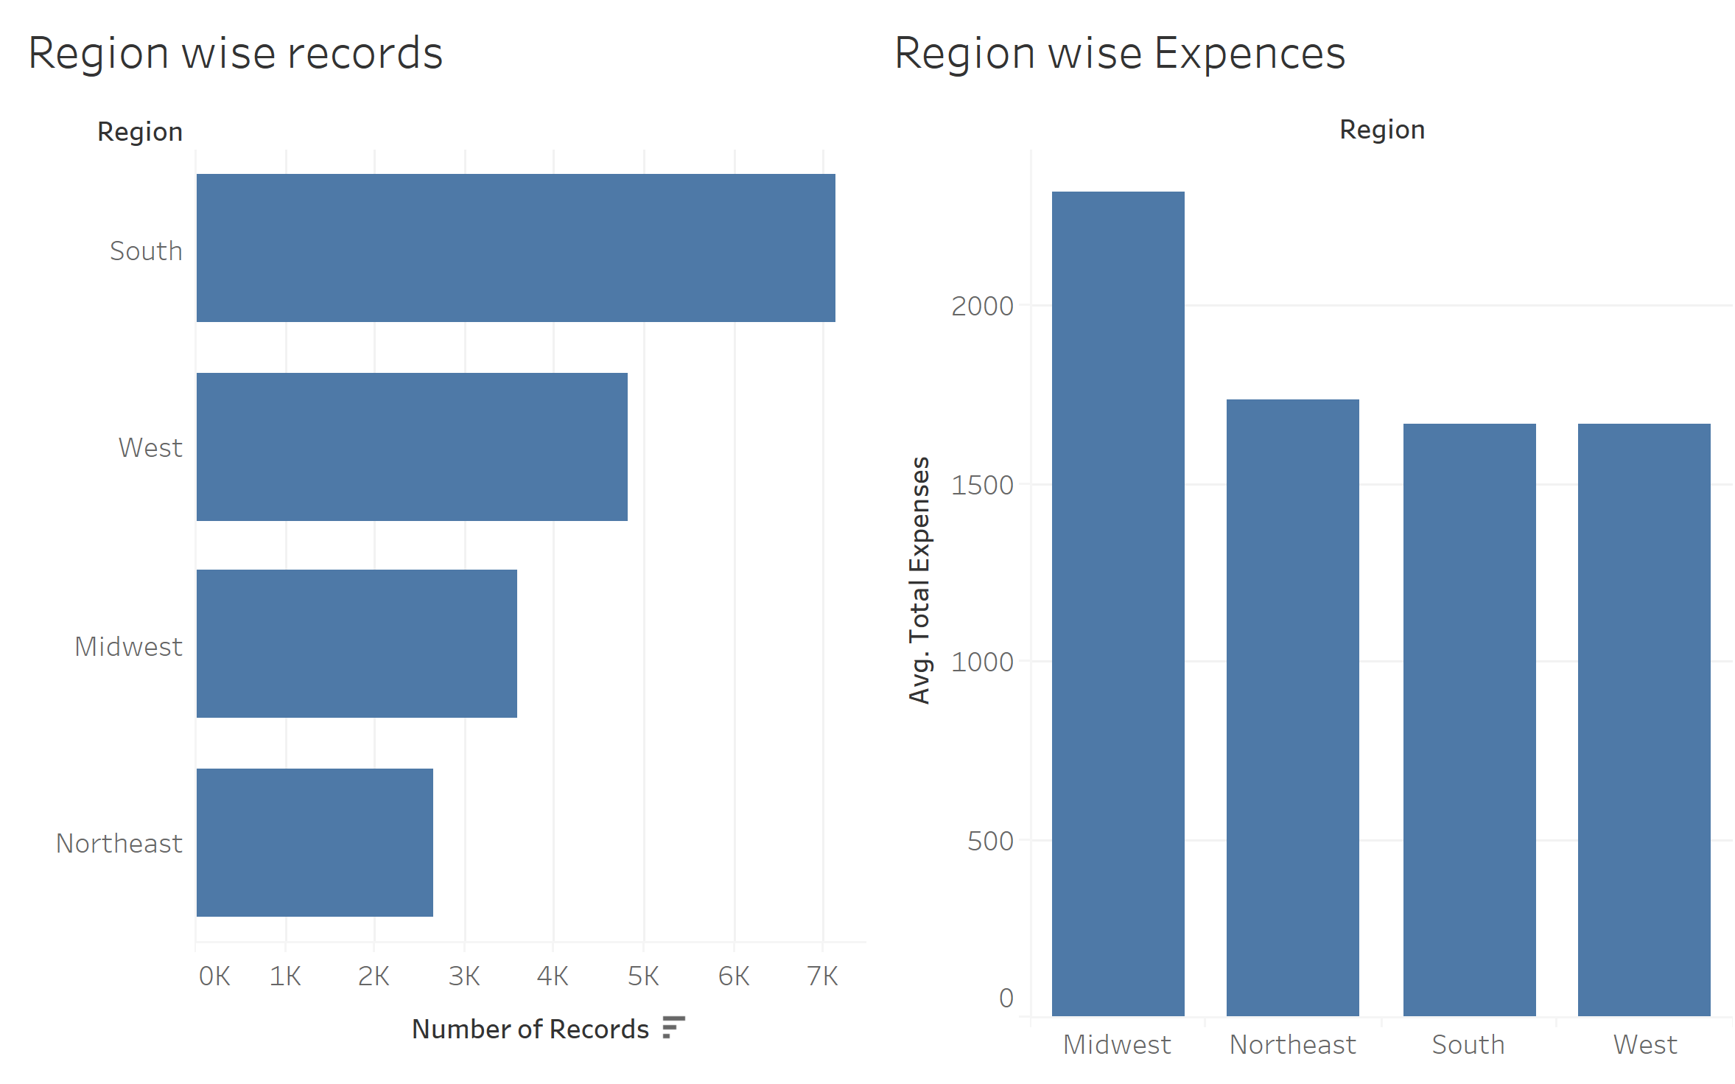
Data Exploration
People in Midwest tend to spend more out of pocket than other regions

Slide 25
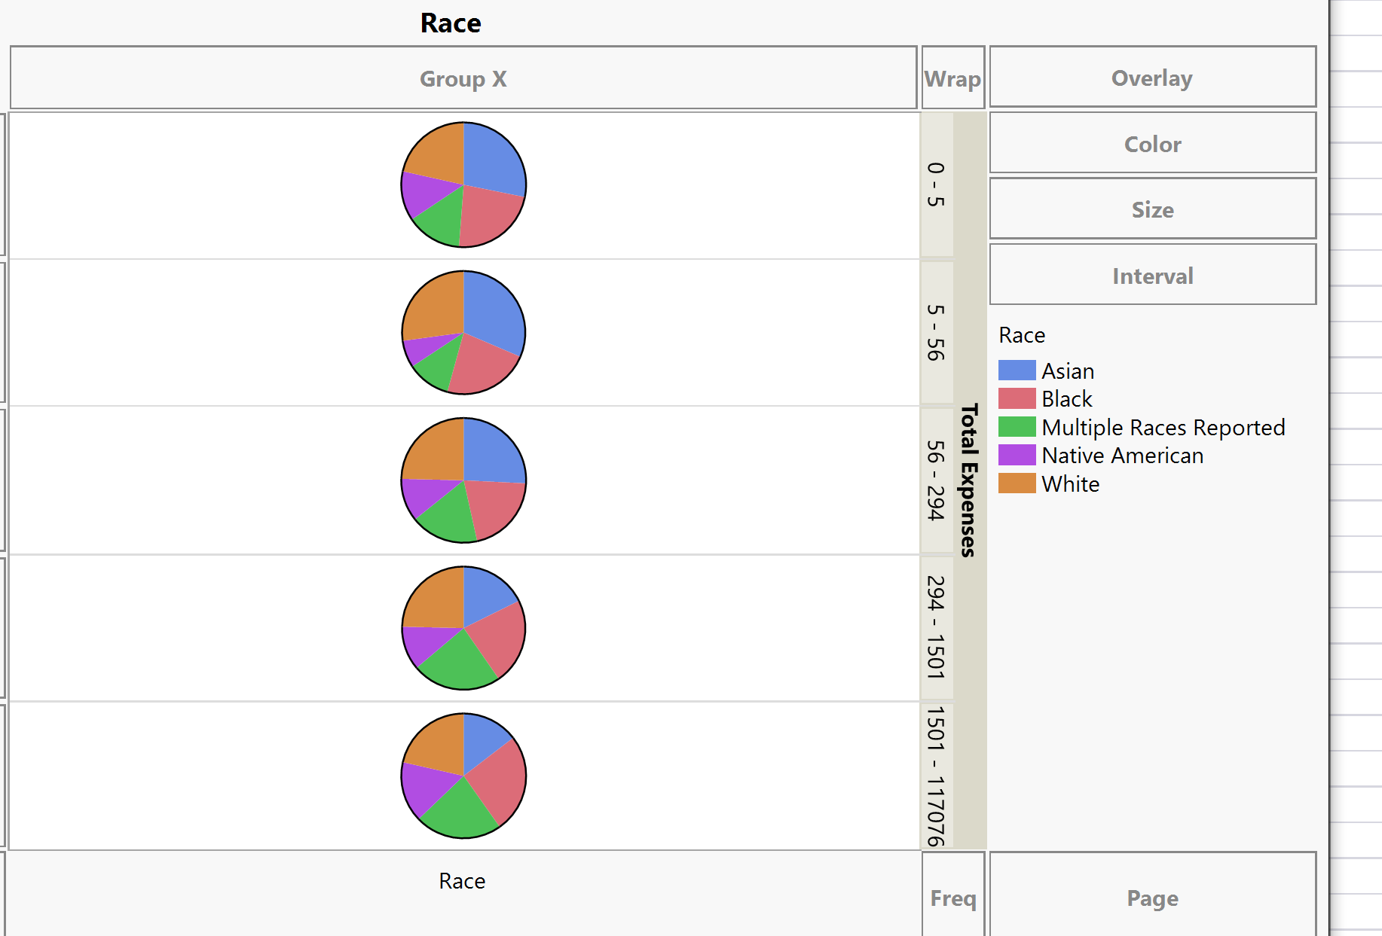
Data Exploration
Stratification to balance the races and regions, but to no effect

Slide 26
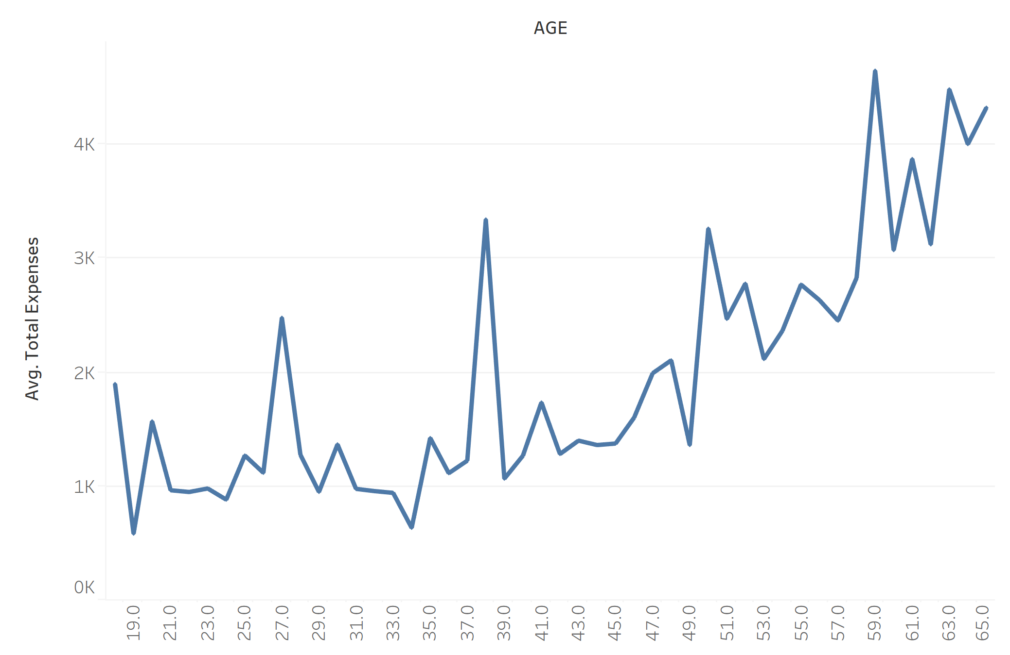
Data Exploration
Average total expenses increase with increasing age

Slide 27

Data Exploration
Industries with low pay or more risk have higher average total expenses

Slide 28

Data Exploration
People with graduate degree have higher expenses

Slide 29

Data Exploration
People who have been divorced or separated have higher total out of pocket expenses

Slide 30

Data Exploration
People with poor mental health have higher out of pocket expenses

Slide 31

Data Exploration
People with public health insurance plan have higher out of pocket expenses
Notes:
People go more to the doctor

Slide 32

Data Exploration
People with usual source of care tend to have multiple visits and higher expenses
Notes:
People go more to the doctor

Slide 33



Variables + Models Attempted

Slide 34


Input Variables Re-examined

Slide 35

Cluster Bi Plot
Cluster 1 = High Risk
Cluster 2 = Lowest Risk
Cluster 3 = Med-High Risk
Cluster 4 = Low-Med Risk

Slide 36

Neural Networks on new cluster category
Improved predictive/classification
Extremely poor at predicting Highest Risk Cat
Despite using Robust Fit/Boosted increased
Iterations, still unable to fit/predict high risk
categories accurately.

Slide 37

Logistic Regression

Slide 38

Naïve Bayes
Observations:
This is the only model that
seemed capable of
predicting any Class 1/High
Risk Categories.
However, not good enough

Slide 39

Decision Tree
Observation:
Each model seems to predict 41 Cat 3’s
as Cat 1’s
Though not well, however we would rather
overpredict Class I risks than underpredict

Slide 40

Bootstrap Forest
The same story, unable to predict Class 1 Risk.

Slide 41
Insights and Recommendations
Like a typical insurance company… we can’t seem to predict high risks accurately with available data, only probability/likelihood of risk. The prevalence of variability across the current variable set we have does not allow us to refine/perform Risk/Ratio analysis.
The recommendation is to build/derive a premium that blends the risk of high claim/expenditures across the other risk classes proportionally (which is what insurance companies seem to do anyway)
Age, having main care provider, pre-existing conditions/physical limitations, family size, and self perceived health all have made a difference in clustering the data, however adverse selection would have to be considered for self perceived health
Dataset was free, and not subject to added rigor/continuous tracking of participant/insured data
Unfortunately we would have to purchase additional data that could be more useful (tickets/arrests, medical tourism etc.)

Slide 42
Works Cited
Panel 7
https://www.meps.ahrq.gov/mepsweb/data_stats/download_data_files_detail.jsp?cboPufNumber=HC-080
Panel 8
https://www.meps.ahrq.gov/mepsweb/data_stats/download_data_files_detail.jsp?cboPufNumber=HC-086
Sample data/Metadata
https://instruction.bus.wisc.edu/jfrees/jfreesbooks/Regression%20Modeling/BookWebDec2010/data.html
Various Images obtained through Google Images

